Slide 1
Repaying Loans
EDA using python (Hackathon II)
DS1_C6_Hackathon_II_KushagraSindhi
PPT by Kushagra Sindhi for the completion of Level 1 – Course 6

Slide 2
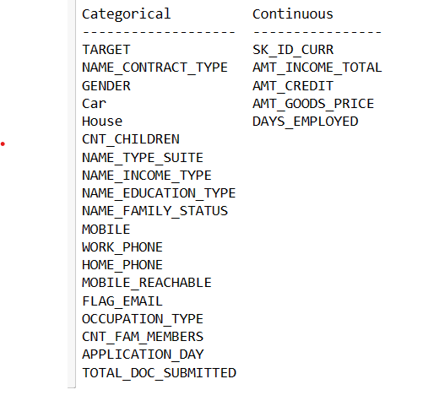
Columns according to their type in the dataset

Slide 3
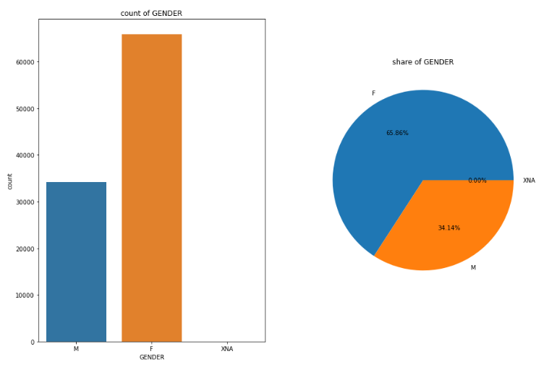
Proportion of gender-wise customers
There are more female customers as compared to men with 65.86% females against 34.14% males

Slide 4
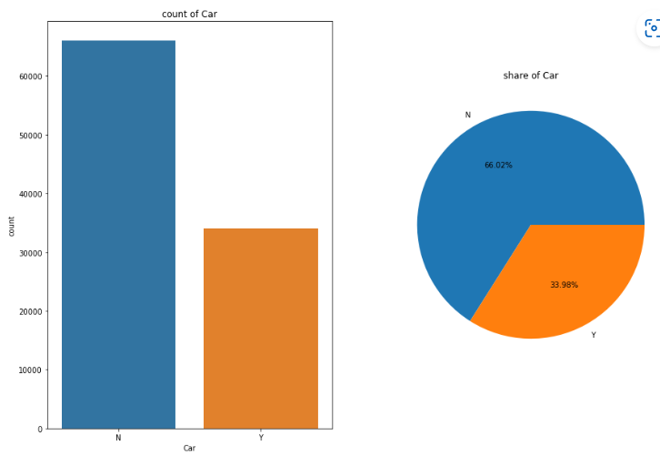
Proportion of car owners against non-owners
66.02% of the customers do not own a car against 33.98% of owners

Slide 5
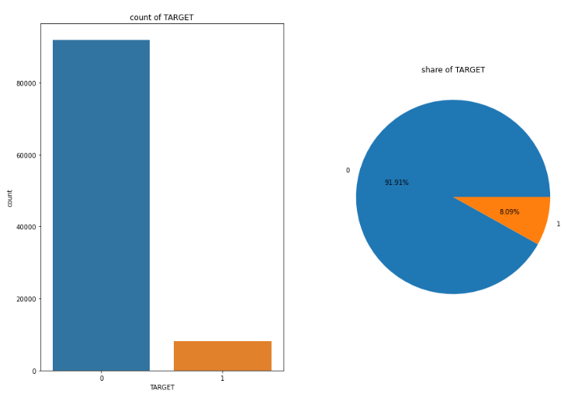
Comparison of loan repayors vs defaulters
91.91 of all customers are likely to repay the loans against a 8.09% of defaulters

Slide 6
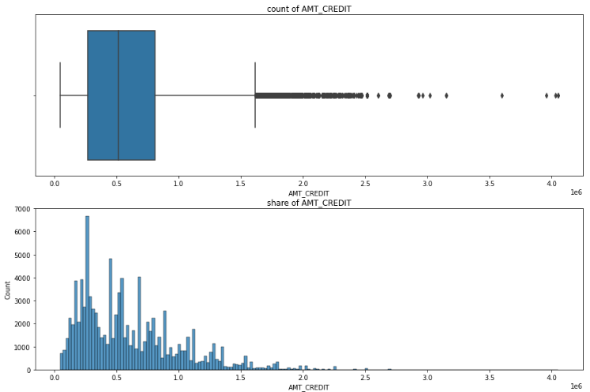
Dispersion of loan amounts
Mean of AMT_CREDIT is 599003.4465
Median of the AMT_CREDIT is 513040.5
Mode of the AMT_CREDIT is 599003.4465
Standard deviation of the AMT_CREDIT is 402051.96

Slide 7
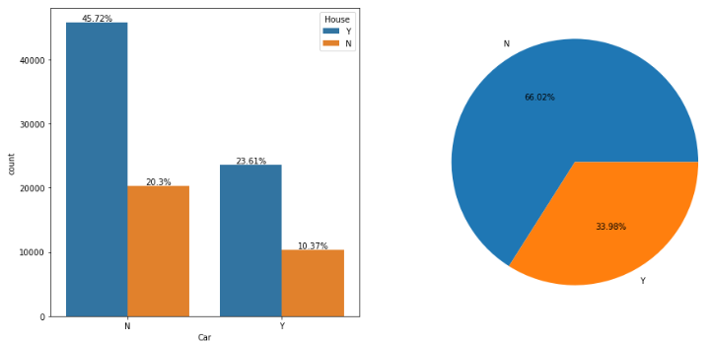
Car and house owners
23.61% of customers owns both car and a house, 20.3% own neither a house or a car

Slide 8
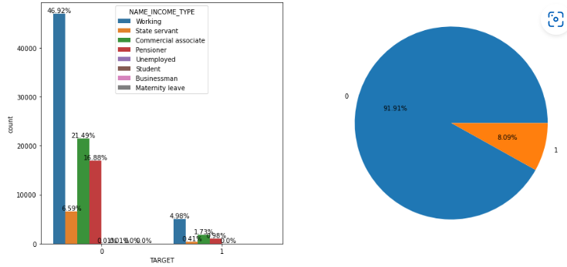
Target and income type of customers
Working customers are more likely to repay the loan.
8.09% of all customers are likely to default

Slide 9
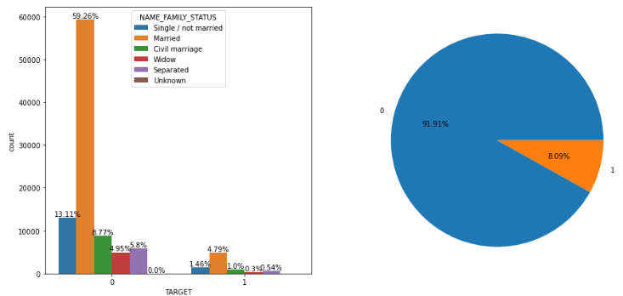
Family status of customers who took loans
Customers who are married are most likely to replay the loan

Slide 10
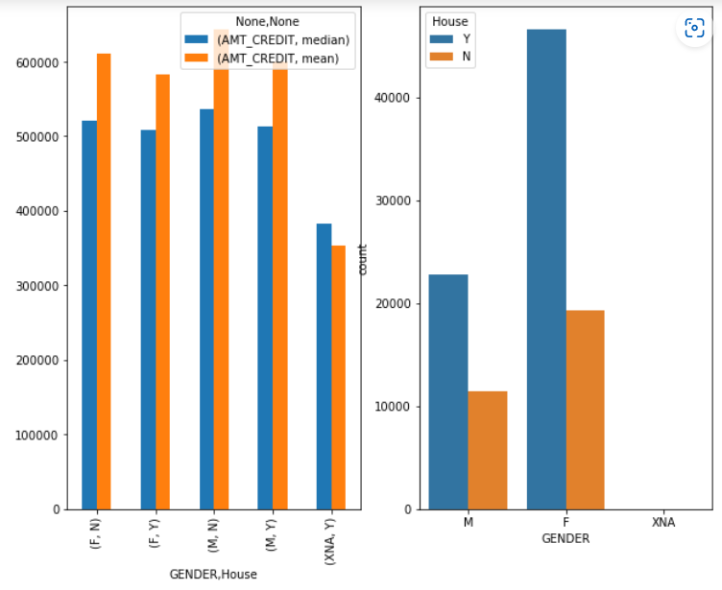
Gender wise-house owners and their loan amounts
People, especially Females who owns a house have a higher credit

Slide 11
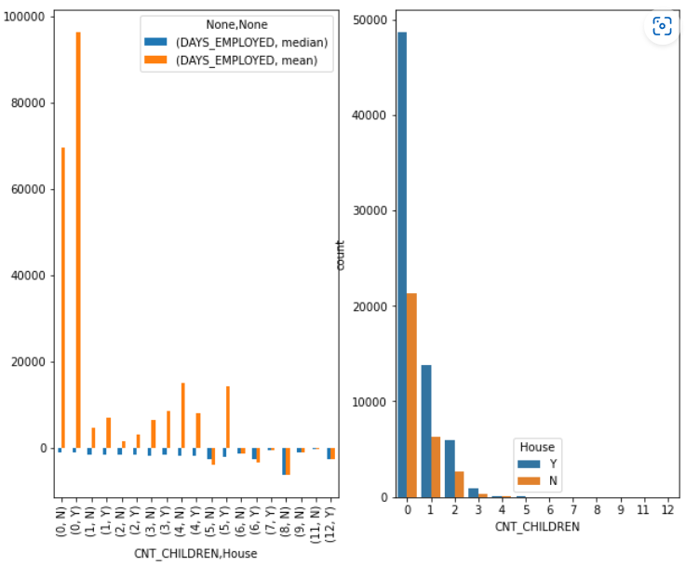
Employed house owners with children
Most people who owns a house and are employed have no children

Slide 12
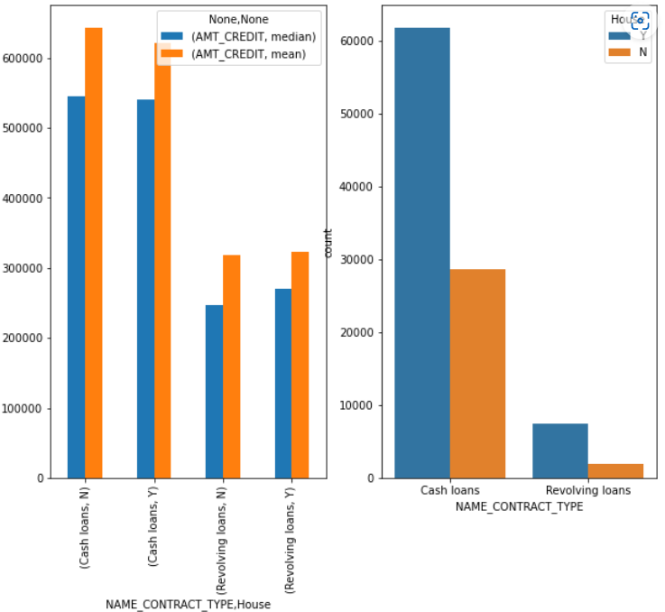
Home-owners who have loans with their loan types
People who owns a house are more likely to get a cash loan

